Slide 1
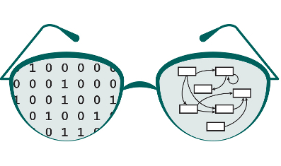

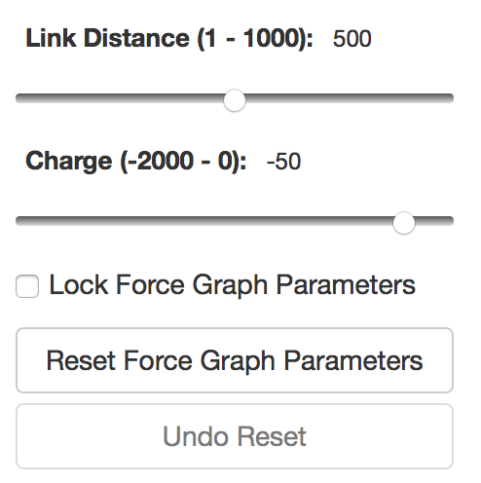
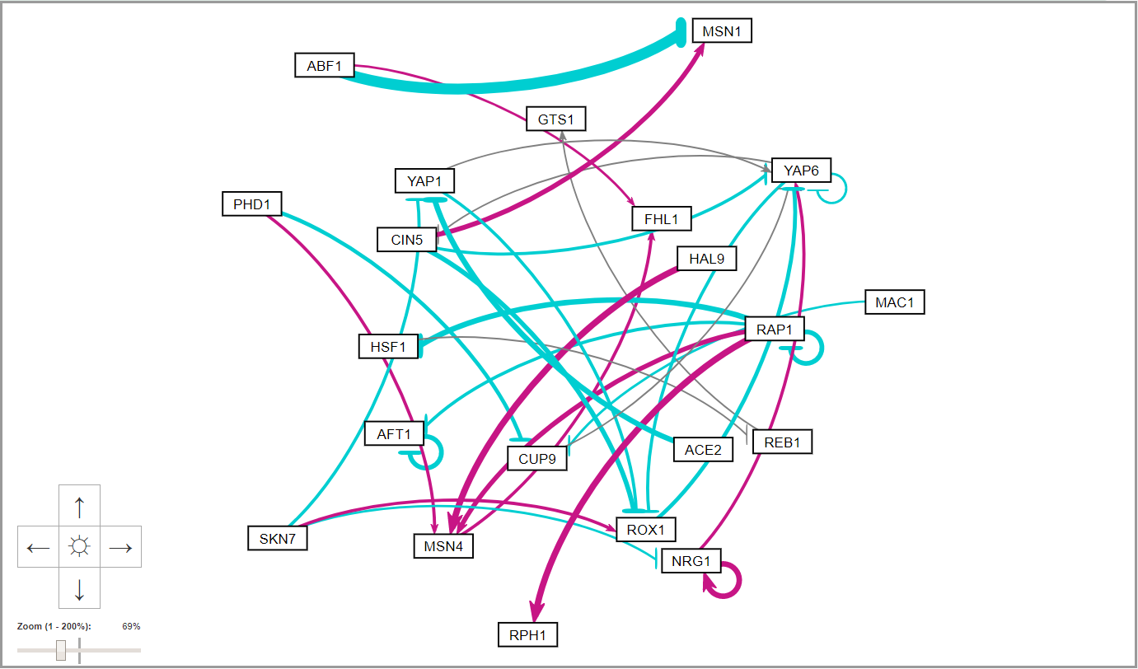
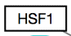
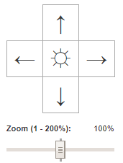
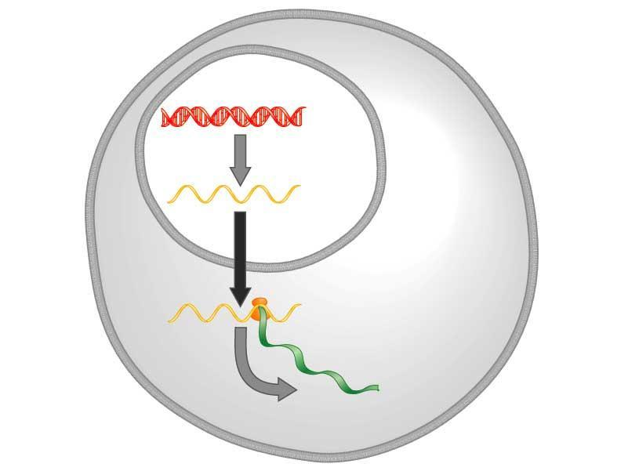
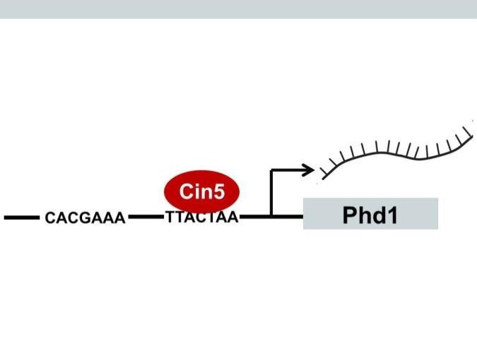
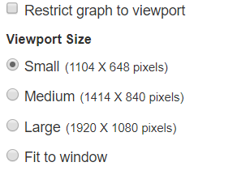
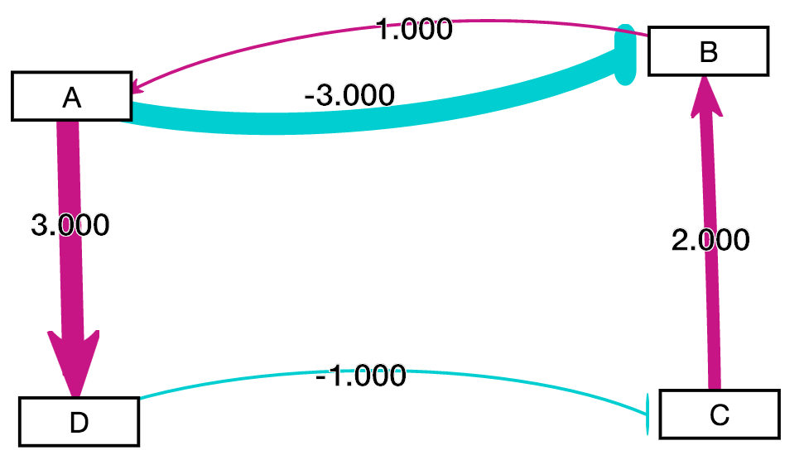
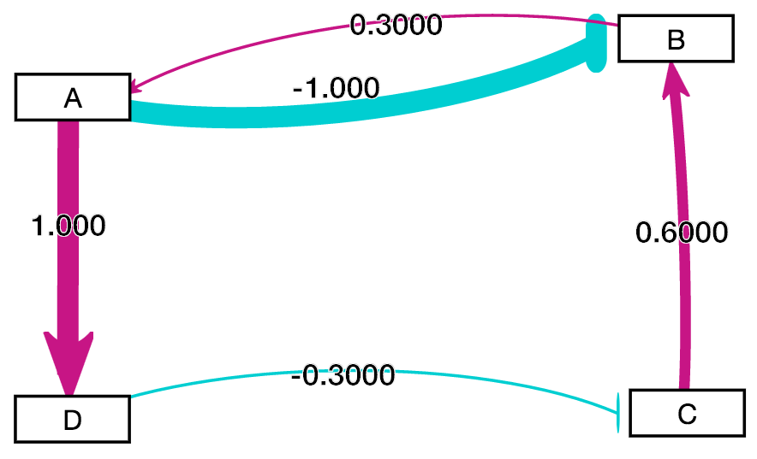
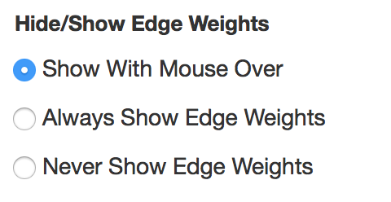
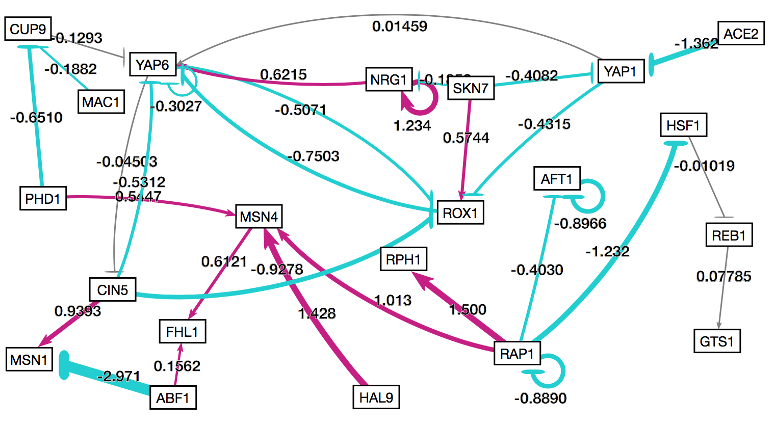
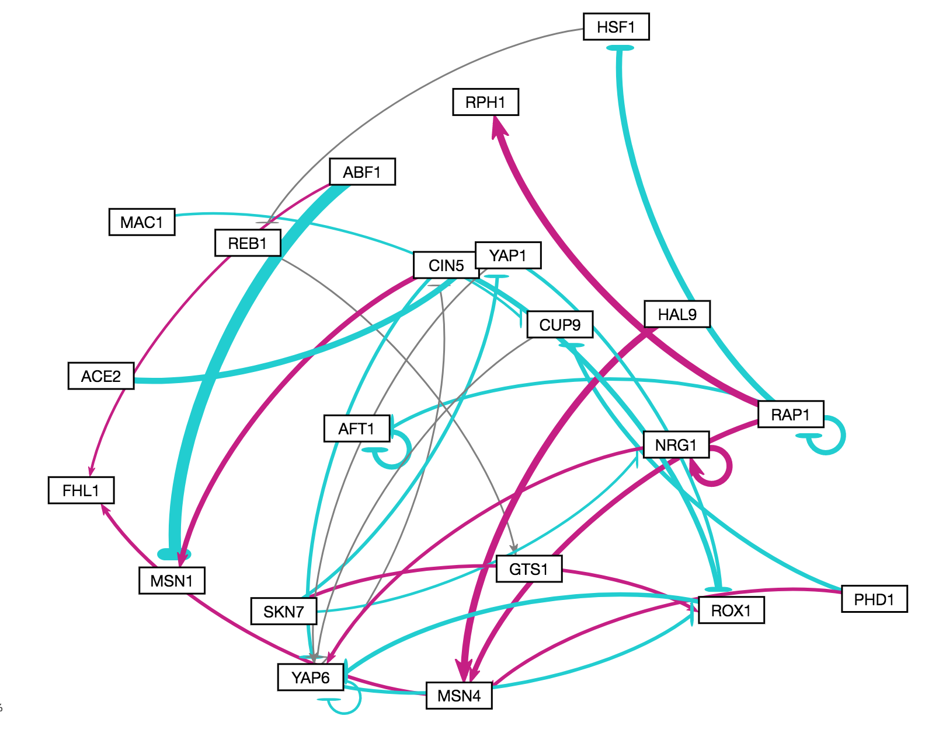
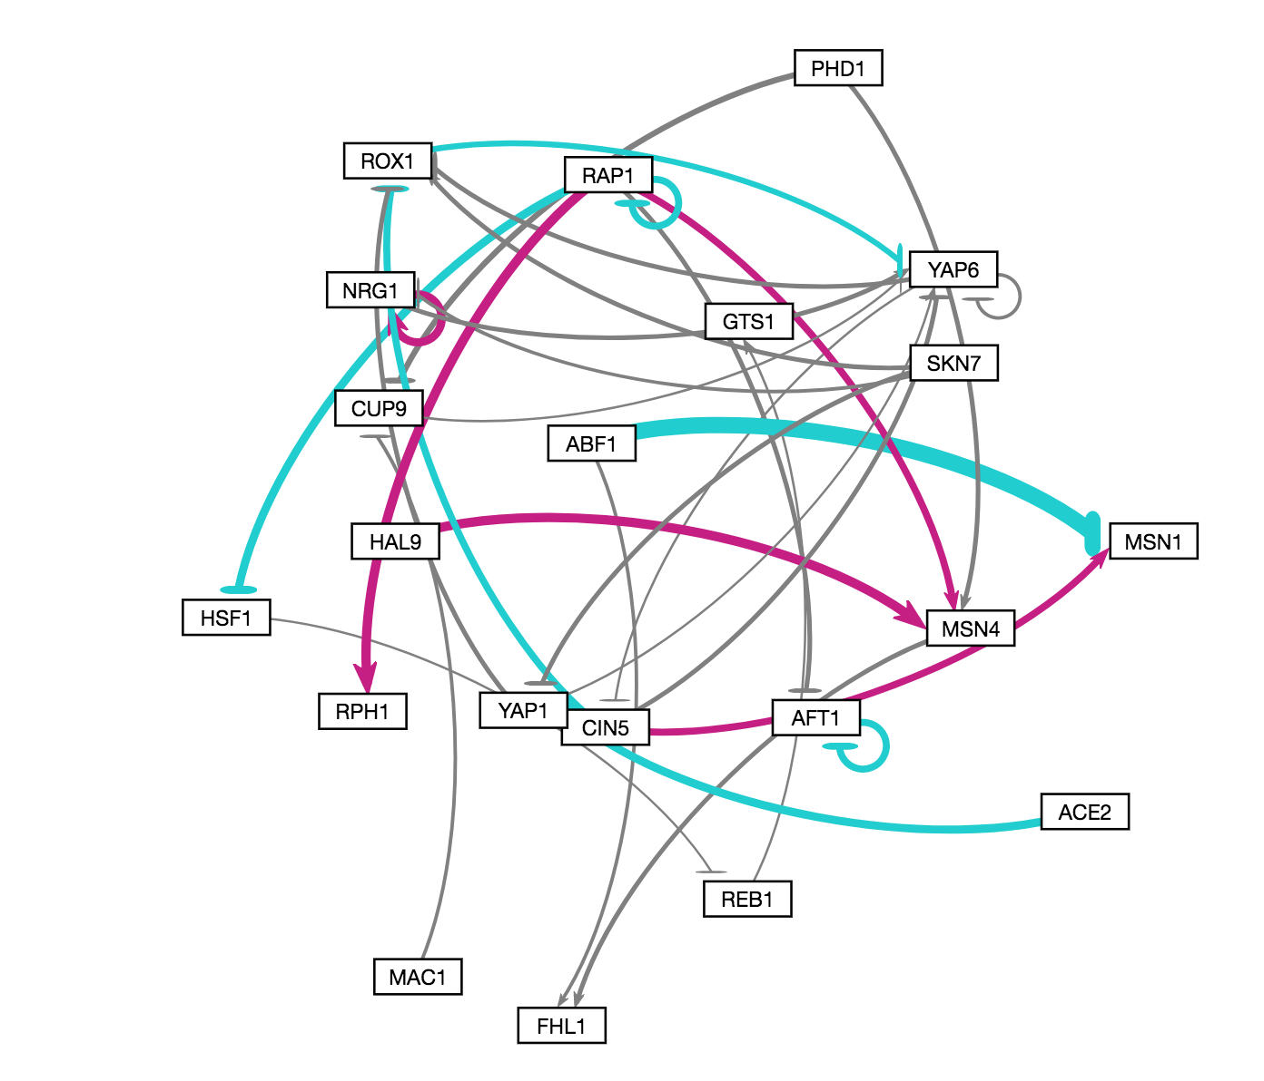
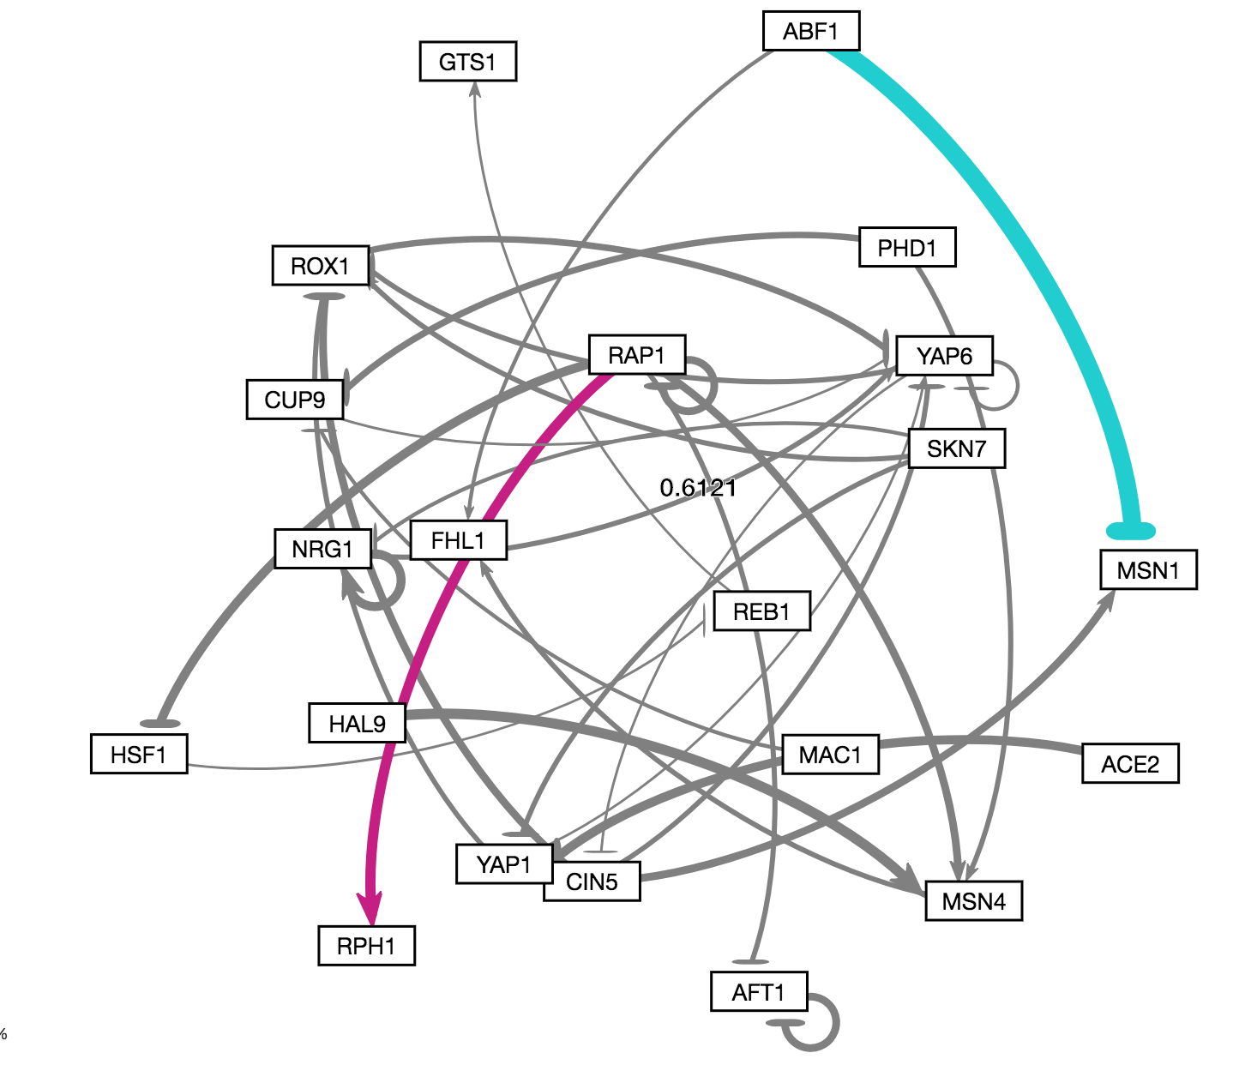
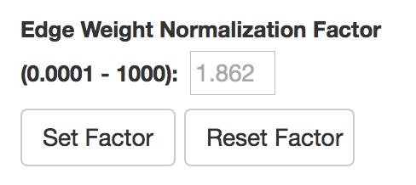
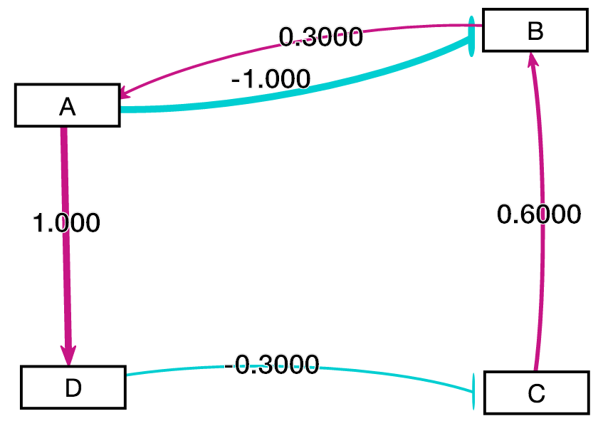
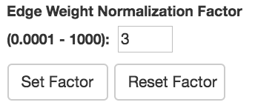
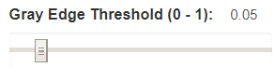
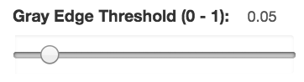
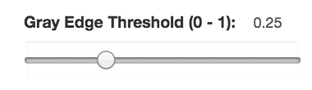
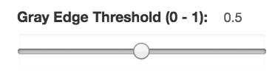
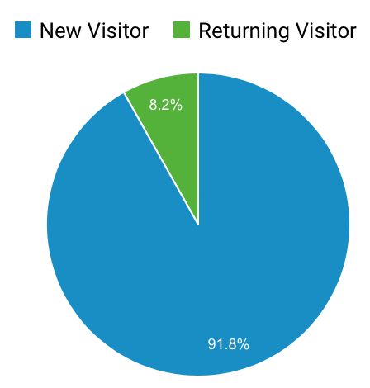
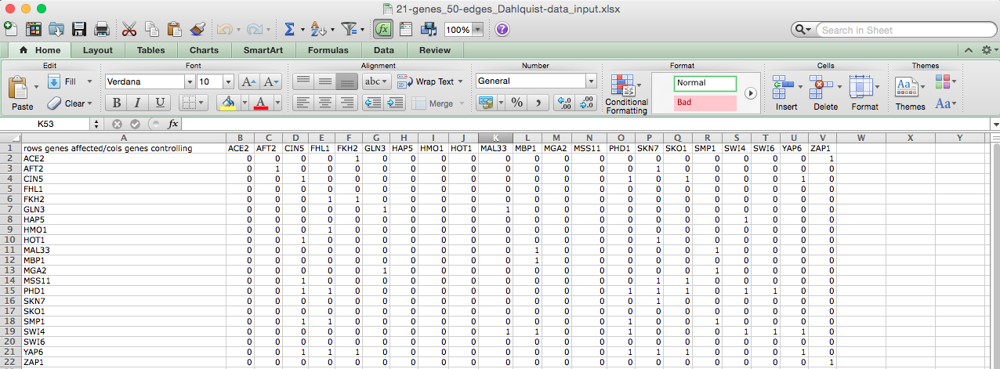
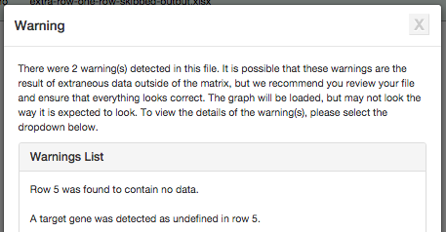
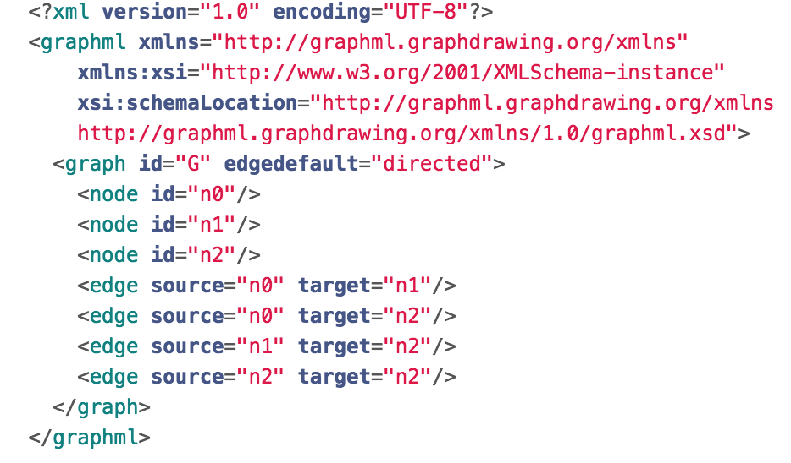
Data Comparison Features and Development Tool Improvements for
GRNsight: a Web App for Visualizing Gene Regulatory Networks
Mihir Samdarshi*, Eileen J. Choe**, Edward B. Bachoura**, Yeon-Soo Shin**, John David N. Dionisio**, Kam D. Dahlquist*
*Department of Biology, **Department of Electrical Engineering and Computer Science, Loyola Marymount University, 1 LMU Drive, Los Angeles, CA 90045
http://dondi.github.io/GRNsight/
Gene Regulatory Networks (GRNs) Can Be Illustrated by Directed Graphs
GRNsight Automatically Lays Out Unweighted and Weighted Network Graphs
The central dogma of molecular biology describes how the flow of information in a cell during gene expression goes from DNA to RNA to protein.
Transcription factors control gene expression by binding to regulatory DNA sequences.
Activators increase gene expression.
Repressors decrease gene expression.
Transcription factors are themselves proteins encoded by genes.
Freeman (2002)
A gene regulatory network (GRN) consists of genes, transcription factors, and the regulatory connections between them, which govern the level of expression of mRNA and proteins from those genes.
Each node in a GRN graph represents a regulatory transcription factor, with each edge representing a regulatory relationship, either an activation or repression relationship.
.
1. File Formats
Can open an Excel workbook and import SIF or GraphML.
Can export graph to Excel format.
Demo files with weighted and unweighted graphs.
1
How to read GRNsight
2
3
gene
Key:
5
5. Improvements to Zoom Functionality
Zoom was first added in GRNsight version 2.0, and has been improved since.
Zoom now originates from the center of the graph
Zoom factor is now annotated on zoom slider
A vertical bar on the zoom slider indicates where the 100% zoom level is.
activation
DNA
2. Force Graph Parameter Sliders
Link distance determines the minimum distance between nodes.
Nodes have a charge, which repels or attracts other nodes.
Reset functionality sets all parameters to default settings.
Locking the parameters prevents any further changes.
repression
RNA
weak influence
Protein
3
6. Edge Weight Normalization
Allows user to set normalization factor in user interface.
Edge thicknesses for different graphs can be rendered on the same scale.
Facilitates accurate visual comparison.
A comparison between a graph with no normalization applied to it, and a graph with a normalization factor of 3 are shown.
5
3. Viewport
Graph bounding box can be separated from viewport.
Multiple viewport sizes available.
Zoom and Scrolling enabled.
4
Circled edge thicknesses are the same although weight values are different
GRNsight Fulfills a Specific Software Niche for Visualizing Small- to Medium-scale GRNs
7
4. GRNsight Beta includes options to show or hide the weight values
Radio buttons were added to the main toolbar to the left of the graph bounding box that enable the user to always see edge weights, never see edge weights, or see edge weights upon mouseover of the edges.
Achieved by leveraging CSS.
6
Although other open source software, such as Cytoscape or Gephi, exists to lay out large networks, they were too cumbersome for our needs.
GRNsight is targeted at both experienced biology investigators and novice undergraduate users and has the following requirements:
Exist as a web application.
Be simple and intuitive to use.
3. Accept Excel (.xlsx) files directly from our sister project, GRNmap, as well as, SIF (.sif), or GraphML (.graphml) input files.
Read a weighted or unweighted adjacency matrix.
Automatically lay out and display unweighted and weighted, directed network graphs.
4
7
7. Gray Edge Threshold
Slider allows the gray edge threshold to be customized.
Gray edges allow users to visually gauge whether a particular regulatory relationship is not important.
By default, edges are colored gray if the magnitude of its value is <= 5% of the maximum edge weight value.
As the threshold value increases, only the highest magnitude regulatory relationships are rendered in color.
Circled edge thicknesses are different when weight values are different
Unit Testing Framework Improvements
Improved Developer Tools
Future Directions
GRNsight Accepts Microsoft Excel, SIF, and GraphML Files in the Proper Format
Mocha and Chai JavaScript testing framework
The unit testing framework consists of 216 passing tests covering over
500 test files.
The addition of SIF and GraphML file format options besides the existing Excel imports, required re-organization of the testing framework.
Testing is now split into two different test groups, with semantic tests being file-format independent, and individualized syntactic tests being based on the different file formats.
Errors found in the semantic checker test are generally considered fatal, whereas most of the syntactic checker tests return warnings and still display the graph.
Syntactic tests for malformed GraphML XML (.graphml) and Simple Interaction Format (.sif) files were completed and incorporated into one file. These tests return errors to the user if an incorrectly formatted file is imported into GRNsight
GRNsight now returns an error if incorrectly named Excel worksheets were added or if a blank Excel, SIF , or GraphML file is uploaded
s
Calculate and present graph statistics, such as betweenness centrality.
Add new graph layout options.
Further expand and refine the unit testing framework.
Node coloring to represent gene expression data.
Changing the color palette for easier visualization by color blind users.
D3 visualization library was updated to version 4
D3 is the central visualization code library that GRNsight uses to lay out nodes and edges in the appropriate manner
GRNsight previously used d3 version 3.
Transitioning to version 4 allowed for a more concise and logical code base, allowing developers to read code easier and code to compile faster.”
Excel
Excel workbooks need a “network” sheet (for unweighted graphs) or a “network_optimized_weights” sheet (for weighted graphs). The adjacency matrix can be symmetrical or asymmetrical.
GRNmap input and output workbooks are accepted without adjustment.
Adjacency matrices generated from other databases, such as YEASTRACT (Teixeira et al., 2014), can be used with some modification.
Availability
The “Gravity” and and “Charge Distance” features previously present in GRNsight were consolidated into “Link Distance” and ”Charge
GRNsight is free and open to all users and there is no login requirement.
Web site content is available under the Creative Commons Attribution Non-Commercial Share Alike license.
GRNsight code is available under the open source BSD license.
ESLint added to code base
ESLint is a “linter,” a tool to identify and correct JavaScript mistakes and coding style errors that developers may make while contributing to GRNsight.
The addition of ESLint ensures that all GRNsight code is consistent with style guidelines.
Usage is being tracked through Google Analytics.
GRNsight has been tested with and confirmed to be working in Chrome version 58 or higher and Firefox version 53 or higher on Windows 7 and Mac OS X.
6236 total visitors and
4521 files uploaded as of
14 March 2018
GRNsight now accepts SIF and GraphML files without any modification
SIF
A SIF file is a tab-delimited text file with the file extension .sif originally created for use with Cytoscape.
Lines in the SIF file specify a source node, a relationship type (or edge type), and one or more target nodes separated by tab characters.
Import Excel
Excel Syntax Checker
Acknowledgments
Import SIF
SIF Syntax Checker
Semantic Checker
GRNsight
This work is partially supported by NSF award 0921038 (K.D.D., B.G.F.), a Kadner-Pitts Research Grant (K.D.D.), the Loyola Marymount University Rains Research Assistant Program (M.S.)
Import GraphML
GraphML Syntax Checker
ESLint can also correct “fatal” coding mistakes prematurely.
GraphML
A GraphML file is an Extensible Markup Language (XML) file with the extension .graphml.
GRNsight parses GraphML to extract nodes and edges.
GraphML has the ability to specify additional graph features that GRNsight cannot display, but may be useful additional data.
Warnings are returned in cases of non-fatal improper spreadsheets
Additional Developer Tools
An automatic client-side test generator was created that generates a document that can be followed by a user to manually systematically test specific combinations of user interface functions.
Incorporated Continuous Integration, or automatic testing and linting of the codebase every time new coded is added to the Github Repository via the service Travis CI.
References
In cases where non-fatal errors exist in the format or data of an uploaded spreadsheet, the graph is displayed, and a warning box appears.
Cytoscape: http://cytoscape.org
Dahlquist, K.D., Dionisio, J.D.N., Fitzpatrick, B.G., Anguiano, N.A., Varshneya, A., Southwick, B.J., Samdarshi, M. (2016) GRNsight: a web application and service for visualizing models of small- to medium-scale gene regulatory networks. PeerJ Computer Science 2:e85. DOI: 10.7717/peerj-cs.85).
Dahlquist, K.D., Fitzpatrick, B.G., Camacho, E.T., Entzminger, S.D., and Wanner, N.C. (2015) Parameter Estimation for Gene Regulatory Networks from Microarray Data: Cold Shock Response in Saccharomyces cerevisiae. Bulletin of Mathematical Biology, 77(8), 1457-1492, DOI: 10.1007/s11538-015-0092-6
D3.js: http://d3js.org/
Freeman, S., (2002). Biological science, 1st edition. Upper Saddle River, NJ:: Prentice Hall.
Gephi: https://gephi.org
GRNmap: http://kdahlquist.github.io/GRNmap/
Teixeira, M. C., Monteiro, P. T., Guerreiro, J. F., Gonçalves, J. P., Mira, N. P., dos Santos, S. C., ... & Madeira, S. C. (2014). The YEASTRACT database: an upgraded information system for the analysis of gene and genomic transcription regulation in Saccharomyces cerevisiae. Nucleic Acids Research, 42(D1), D161-D166, DOI: 10.1093/nar/gkt1015
Warnings clearly state which row(s) or cell(s) may have incorrect data.
The warning box can be closed and reopened at any time via a hyperlink underneath Force Graph Parameter sliders.
Notes:
Kill abstract
Change to sans serif font
Make title bigger
Make title background white
Use full names
Super script to associate names with correct department
Background color: make it dark green, make writing on white background and writing in black/dark green
4 columns!!!
Smaller pictures
Bold titles
References can be 12pt
Acknowledgements can be 16pt
Everything else is 18-24pt
Titles don’t need to be bigger than 36pt
Remove circles from the arrowhead diagram, group the related labels together
Include menu bar
Testing/error handling – sample error (we don’t crash with errors!)
Mouseovers for edges screenshot

